Slide 1

Project Life Cycle

Slide 2
Project Life Cycle
A project life cycle is the series of phases that a project passes through from its initiation to its closure.
A project phase is a collection of logically related project activities that culminates in the completion of one or more deliverables.
Two basic types of phase-to-phase relationships:
Sequential relationship. In a sequential relationship, a phase starts only when the previous phase is complete.
Overlapping relationship. In an overlapping relationship, a phase starts prior to completion of the previous one.

Slide 3
Project Life Cycle
Predictive Life Cycles
Predictive life cycles (also known as fully plan-driven) are ones in which the project scope, and the time and cost required to deliver that scope, are determined as early in the project life cycle as practically possible.
Iterative and Incremental Life Cycles
Iterations develop the product through a series of repeated cycles, while increments successively add to the functionality of the product.
Adaptive Life Cycles
Adaptive life cycles (also known as change-driven or agile methods) are intended to respond to high levels of change and ongoing stakeholder involvement.
Adaptive methods are also iterative and incremental, but differ in that iterations are very rapid (usually with a duration of 2 to 4 weeks) and are fixed in time and cost.

Slide 4
Existing Agile Methods
Extreme Programming (“XP”)
Scrum
Dynamic Systems Development Method (DSDM)
Feature Drive Development (FDD)
Lean Software Development (LSD)
Agile Modeling (AM)
Agile Unified Process (AUP)
Kanban

Slide 5
Extreme Programming
Extreme Programming (XP) is an Agile software development methodology that emphasizes customer satisfaction, flexibility, and high-quality software through frequent releases and constant communication between developers and stakeholders.

Slide 6
Extreme Programming Core Practices
Principle or practice | Description
Incremental planning | Requirements are recorded on story cards The developers break these stories into development ‘Tasks’.
Small releases | The minimal useful set of functionality that provides business value is developed first. Releases of the system are frequent and incrementally add functionality to the first release.
Simple design | Enough design is carried out to meet the current requirements and no more.
Test-first development | An automated unit test framework is used to write tests for a new piece of functionality before that functionality itself is implemented.
Refactoring | Code is continuously improved or “refactored” to keep it clean, simple, and efficient. This keeps the code simple and maintainable.

Slide 7
Extreme Programming Core Practices (B)
Pair programming | Developers work in pairs, checking each other’s work and providing the support to always do a good job.
Collective ownership | The pairs of developers work on all areas of the system, all the developers take responsibility for all of the code. Anyone can change anything.
Continuous integration | As soon as the work on a task is complete, it is integrated into the whole system. After any such integration, all the unit tests in the system must pass.
Sustainable pace | Large amounts of overtime are not considered acceptable as the net effect is often to reduce code quality and productivity
On-site customer | A representative of the end-user of the system (the customer) should be available full time. In an extreme programming process, the customer is a member of the development team and is responsible for bringing system requirements to the team for implementation.

Slide 8
The Extreme Programming Release Cycle

Slide 9
Example – Story Card For Downloading Document

Slide 10
Task Cards

Slide 11
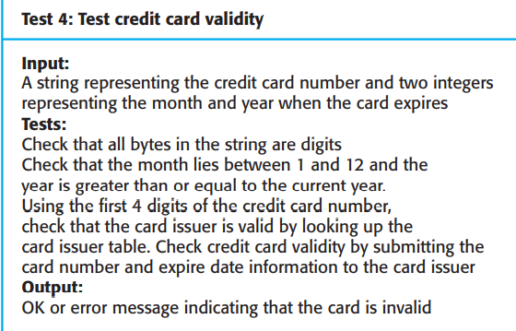
Test case description for credit card validity

Slide 12
Scrum
Scrum is an Agile framework used for managing complex projects, particularly in software development.
Scrum breaks work into short, consistent cycles called sprints, which typically last 2-4 weeks.
The goal of Scrum is to deliver a potentially shippable product increment at the end of each sprint, ensuring continuous improvement and adaptability.

Slide 13
Key Components of Scrum
1. Roles:
Product Owner:
- Represents the stakeholders.
- Responsible for defining and prioritizing the *Product Backlog*, which is a list of features or tasks to be completed.
Scrum Master:
- A Scrum master is a facilitator for an Agile development team. They are responsible for managing the exchange of information between team members.

Slide 14
Key Components of Scrum
Development Team.
Group of professionals (developers, designers, testers, etc.) responsible for delivering the product increment during each sprint.
2. Artifacts:
Product Backlog:
A prioritized list of all the work that needs to be done for the product. It is dynamic and evolves over time as new information becomes available.
Managed by the Product Owner, it includes user stories, bug fixes, features, and other tasks.
Sprint Backlog:
A subset of the Product Backlog, selected for a single sprint.

Slide 15
Key Components of Scrum
Events (Ceremonies):
Sprint: A time-boxed iteration (usually 2 to 4 weeks) during which the Scrum Team works to deliver a potentially shippable product increment.
Sprint Planning:A meeting held at the start of each sprint to define what will be worked on and how the team plans to complete the selected items.
- The team selects items from the Product Backlog to form the Sprint Backlog and sets a Sprint Goal.
Daily Scrum:A short, time-boxed meeting (usually 15 minutes) held daily. Each team member answers three key questions:
1. What did I do yesterday?
2. What will I do today?
3. Are there any impediments in my way?

Slide 16
Key Components of Scrum
Sprint review meeting: At the end of each sprint, the team demonstrates the completed functionality at a sprint review meeting, during which, the team shows what they accomplished during the sprint.
Sprint retrospective: Also at the end of each sprint, the team conducts a sprint retrospective, which is a meeting during which the team (including its Scrum Master and product owner) reflect on how well Scrum is working for them and what changes they may wish to make for it to work even better.

Slide 17
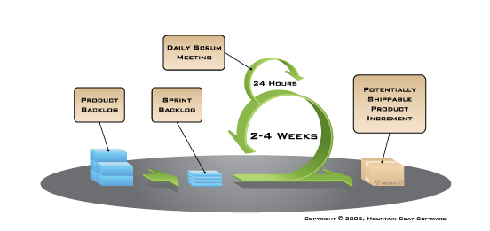

Slide 18
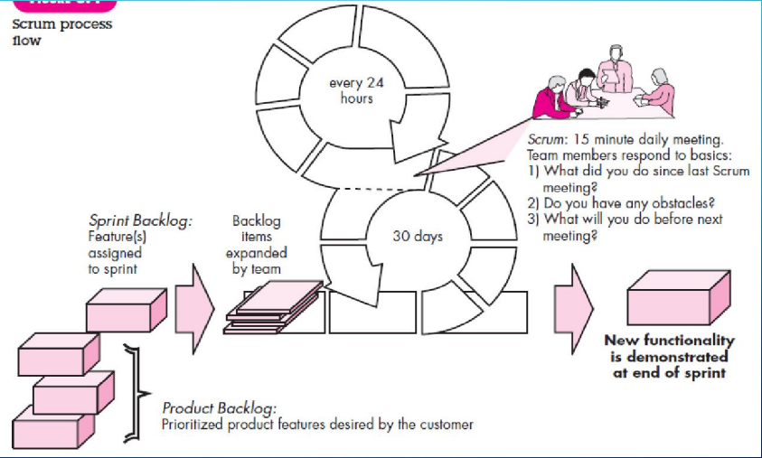

Slide 19
KANBAN – A Work Visualization Tool
Kanban is an agile approach that focuses on continuous delivery, visualizing work, and limiting work in progress (WIP) to improve efficiency and flow within a project.
It originated in manufacturing (specifically from Toyota's production system) but has since been adapted for software development and project management.
Kanban means signboard or billboard in Japanese.

Slide 20
Core principles for Kanban in software development
Kanban method has three basic principles, that everyone should follow to achieve an improvement in a software development team's performance.
Workflow illustration / Visualizing Workflow
Kanban uses a visual board to represent the flow of tasks. Tasks (or user stories) are displayed as cards on the board, usually categorized into columns that represent different stages of work, such as "To Do," "In Progress," and "Done.“
The Kanban board helps team members and stakeholders visualize the current status of tasks and identify bottlenecks or areas of delay.

Slide 21
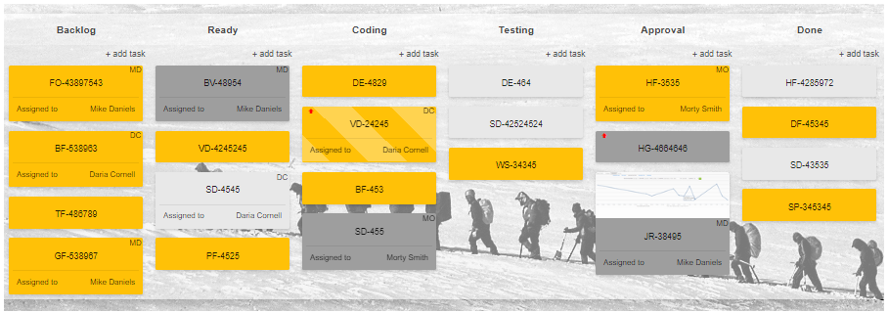
Kanban board for software development processes

Slide 22
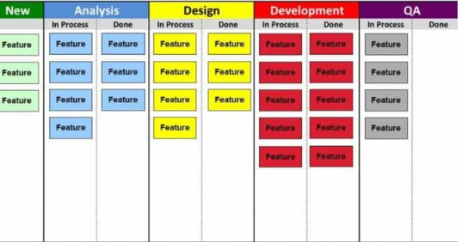
Kanban board for software development processes
Tasks are moved from left to right as they progress through the stages.
WIP limits may be set on columns (e.g., no more than 3 tasks in "In Progress" at once).

Slide 23
Core principles for Kanban in software development
Limiting Work in Progress (WIP)
One of Kanban's core principles is to limit the number of tasks that are in progress at any given time.
WIP limits are set for each stage of the process to ensure that the team is not overburdened, maintaining a smooth and consistent workflow.
Before a new Kanban card can be moved over to the next column, the card you’re currently working on has to be marked as done.

Slide 24
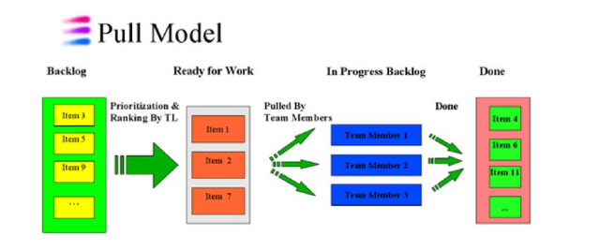
PULL SYSTEM Showing Prioritization
In Kanban, tasks are "pulled" into the next stage of work when there is capacity to work on them, rather than being "pushed" based on a pre-defined schedule.
This system ensures that the team is only working on tasks they can handle, optimizing productivity and preventing overloading.

Slide 25
Measuring Flow
Kanban uses metrics like Cycle Time(the time it takes to complete a task) and Throughput(the number of tasks completed in a given period) to measure performance and identify areas for improvement.
Monitoring these metrics helps in ensuring that work is flowing smoothly across the board and helps teams make data-driven decisions.

Slide 26
Agile Method Applicability
Custom system development within an organization, where there is a clear commitment from the customer to become involved in the development process
Nor should agile methods be used for critical systems development where a detailed analysis of all of the system requirements is necessary to understand their safety or security implications.

